Slide 1

Helping users navigate data specifications
Data specification navigator
Quoc Anh Nguyen

Slide 2


Slide 3
Motivation – the problem
Users want data but don’t know SPARQL or the domain very well.
They rely on a human expert.
This creates a bottleneck in organizations.

Slide 4
Goals
Maps natural-language questions to items in data specification.
Generates SPARQL queries.
Suggests related items to refine queries.

Slide 5
Dataspecer
Ongoing project at KSI.
Tool for management of semantic data specifications.

Slide 6
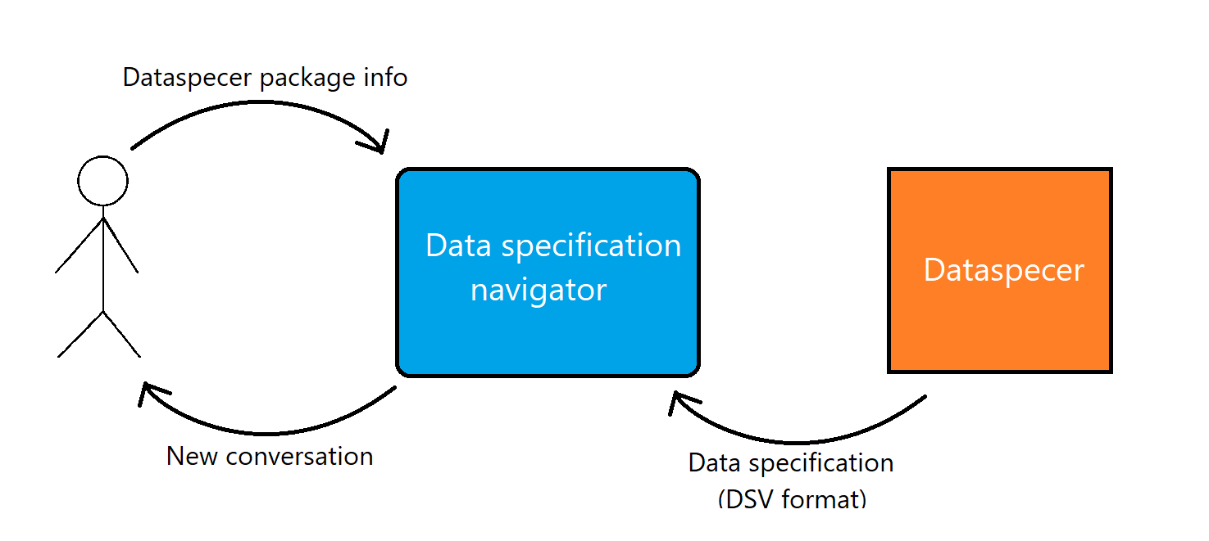
Input and output

Slide 7
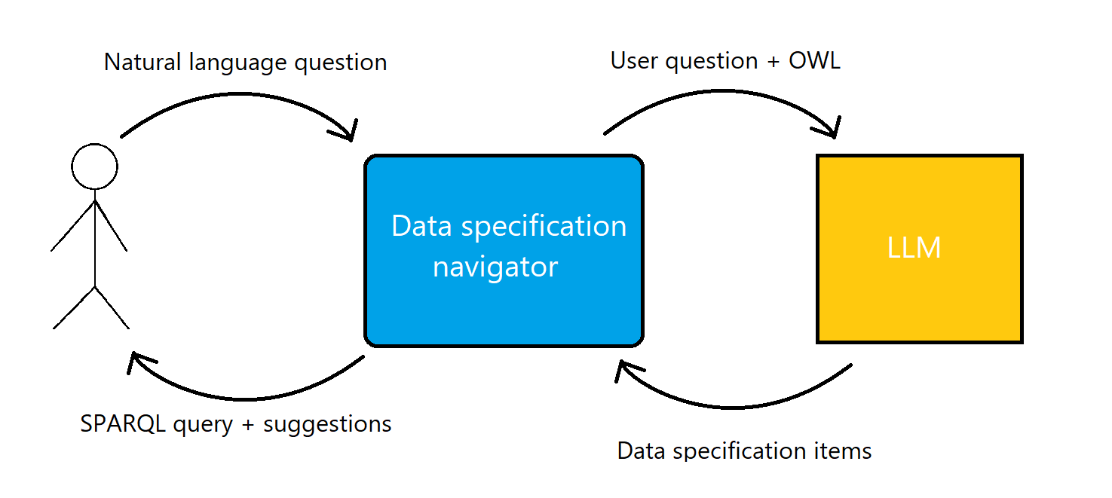
Input and output cont.

Slide 8
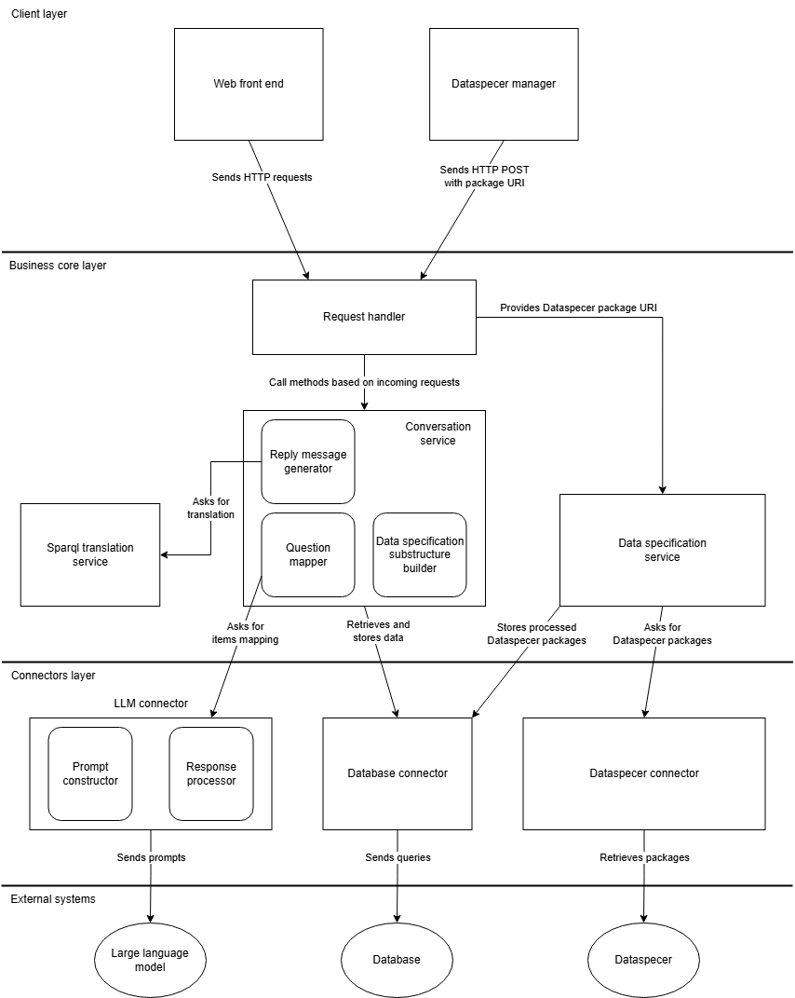
System Architecture

Slide 9





Technologies

Slide 10
Demo
Screenshots

Slide 11
Successfully implemented
DSV to OWL conversion.
Mapping concepts from natural language to data specifications.
SPARQL generation.
Suggestions for natural-language question.
Foundation for future extension and research.

